Slide 1
10th Edition TECHgium®
PID No.
Efficient & User-Controllable Context Memory for AI
Author 1
Photo
Author 2
Photo
Author 3
Photo
Author 4
Photo
Pratigsha S A
Ram Sudharsan
mageshwaran
Praveen Babu B
HINDUSTHAN INSTITUTE OF TECHNOLOGY, COIMBATORE, TAMIL NADU

Slide 2

Challenge Statement
“AI decides what to remember, what to summarize, and what to forget — with the user in control
CONTEXT GROWTH
COST & LATENCY
RELEVANCE LOSS
Every session adds messages, tool outputs and intermediate reasoning.
Sending more context increases token consumption and can slow inference.
Important facts can become harder to use inside very long contexts.
LOW VISIBILITY
NO SAFE RECOVERY
MODEL DEPENDENCE
Users often cannot see why an agent remembered or forgot something.
A wrong summary or deletion can force users to restart the task.
Memory logic should work across different LLM providers.

Slide 3
Concept / Proposed Solution
USERS MESSAGES
Smart Memory Detection – Identify important information from long conversations.
Keep, Summarize or Discard – Automatically decide how each piece of information should be stored.
User-Controlled Memory – Allow users to view, edit, keep, or delete memories.
Memory Chain & History – Record every memory decision with its reason and changes.
Efficient Context Retrieval – Retrieve only relevant memories when the AI needs them.
Model-Independent Design – Build the memory system so it can work with different AI models
MEMORY DECISION ENGINE
Keep full
Summarize
Discard
Exact memory
Short memory
Remove
01
02
03
04
05
06
INGEST
SCORE
DECIDE
VERSION
RETRIEVE
RESPOND
New message / tool result
Relevance • durability • sensitivity
Keep • summarize • discard
Save decision + rationale
Select task-relevant memory
Agent answers with compact context

Slide 4

Pros and Cons of the solution
ADVANTAGES
LIMITATIONS / RISKS
!
Bad summarization can remove a critical detail
✓
Lower context tokens, cost and latency
!
Scoring adds compute and engineering complexity
✓
Transparent memory decisions with reasons
!
Version graphs can grow large over time
✓
Restore, branch and merge instead of restarting
!
Merge conflicts need explicit rules
✓
Manual user control over trim / expand
!
Privacy and deletion policies must be enforced
✓
Works with multiple LLM providers
!
Quality must be measured, not assumed
✓
Version history supports debugging and trust

Slide 5
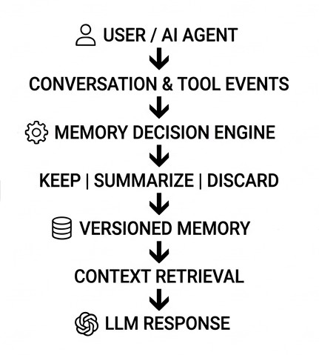
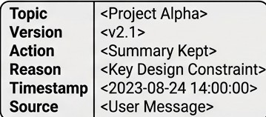
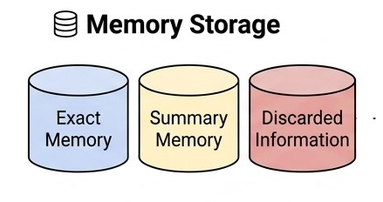

Technical Description
MEMORY DECISION ENGINE
Versioned memory
Relevance
Durability
Recency
Sensitivity
Redundancy
User control
TECH STACK:
Frontend: React / HTML-CSS-JS Backend: Python + FastAPI
Database: PostgreSQL + pgvector
AI Layer: Model-Independent LLM API
Deployment: Docker + Cloud text

Slide 6
Implementation Plan
🔵 FOUNDATION
🧠 MEMORY ENGINE
👤 USER CONTROL
🚀 INTEGRATION
“Build the Base”
“Think & Decide”
“You Stay in Control”
“Connect & Deploy”
①
PHASE-1
②
PHASE-2
③
PHASE-3
④
PHASE-4
FOUNDATION
MEMORY ENGINE
USER CONTROL
DEPLOYMENT
Fast API Backend
PostgreSQL + pg vector
User & Message Models
Versioned Memory Schema
Memory Scoring
Relevance & Recency
Keep / Summarize / Discard
Memory Versioning
View Memories
Edit / Delete
Trim / Expand
Restore Previous Versions
Frontend + Backend
LLM Integration
Testing & Validation
Docker + Cloud Deployment
→
→
→

Slide 7
Cost Estimate
Hardware
Laptop / PC: ₹40,000
Cloud/Storage: ₹2,000
Network & accessories: ₹1,000
Total: ₹43,000
Software
Python: Free
AI/LLM APIs: ₹3,000
Database & development tools: ₹1,000
Total: ₹4,000
Estimated Initial Cost:
₹54,000
Development
Data collection & preprocessing: ₹2,000
Memory-management module: ₹3,000
Testing & debugging: ₹2,000
Total: ₹7,000
Maintenance
Cloud/API usage: ₹2,000/year
Updates & improvements: ₹2,000/year
Backup & monitoring: ₹1,000/year
Total: ₹5,000/year

Slide 8
Validation / Testing / Analysis
TESTING ANALYSIS AND VALIDATION
B
A
C
D
TESTING
RESULT
VALIDATION
ANALYSIS
Testing: Test Smart, Build Better
Validation: Validate Right, Trust Results
Analysis: Analyze Deep, Improve More
Result: Better Memory, Better AI
Memory classification testing
Keep / Summarize / Discard decisions
User memory controls
Retrieval accuracy testing
Reduced unnecessary memory
Faster context retrieval
Better information consistency
Transparent & user-controlled memory
Check relevance of stored memories
Verify correct memory retrieval
Test outdated/conflicting information
Validate user edits and deletions
Memory usage comparison
Context size reduction
Response efficiency
Accuracy of retrieved information

Slide 9
Validation / Testing / Analysis
A
B
C
D
TESTING
VALIDATION
ANALYSIS
RESULT
Memory classification testing
Keep / Summarize / Discard decisions
User memory controls
Retrieval accuracy testing
Check relevance of stored memories
Verify correct memory retrieval
Test outdated/conflicting information
Validate user edits and deletions
Memory usage comparison
Context size reduction
Response efficiency
Accuracy of retrieved information
Reduced unnecessary memory
Faster context retrieval
Better information consistency
Transparent & user-controlled memory

Slide 10
Assumptions
01
running conversations must have lasting memory
02
important details should be kept
03
people can control their memories by looking at them changing them or removing them
04
the AI is able to find important memories
05
there is a database or storage system to keep the memories
06
the internet and large language models and other tools are accessible
07
user permission is given to store private information
08
testing the first version uses made-up conversation data

Slide 11
References
Retrieval-Augmented Generation Patrick Lewis et al. — NeurIPS 2020 [PAPER]
MemGPT: Towards LLMs as Operating Systems
Charles Packer et al. — 2023 [PAPER]
Attention Is All You Need
Ashish Vaswani et al. — NeurIPS 2017 [PAPER]
OpenAI — Official API Documentation LLM API & AI development [DOCUMENTATION]
Anthropic — Official Documentation Context windows & long-context
management [DOCUMENTATION]
PostgreSQL — Official Documentation Database & data persistence
[DATABASE]
pgvector — Official Documentation Vector similarity search for PostgreSQL [DOCUMENTATION]

Slide 12
Abstract
The objective of this project is to propose an efficient information management system which allows AI to operate in a manner, which would help it to learn and retain essential information across extended conversations with a human being. Existing memory systems which allow AI to learn from prior interactions can lead to bloat due to the incorporation of irrelevant information which can affect the accuracy of future responses.
The proposed project is an advanced memory management system, which allows AI to learn and operate efficiently by storing only relevant information which can improve performance on future tasks. The memory system works by detecting relevant information, which includes facts, preferences, tasks, and events, and storing them in a structured data format, which can be retrieved later. This system is more efficient compared to existing systems because it does not require recalling all the information in the memory, which can be time-consuming and may lead to errors.
One of the significant advantages of the proposed memory management system is that it is designed to be customizable, allowing users to edit or delete specific information in the AI memory. The system can also be utilized to manage conflicting information and outdated information, which can adversely impact the performance of AI systems.
In summary, the proposed AI memory management system can be described as an efficient, convenient, flexible, and customizable information management framework, which can enable AI agents to provide accurate and consistent responses while reducing bloat and context and memory overhead.

Slide 13
Thank You

